Slide 1
Progress in CovidSIMVL
Dec 14, 2020

Slide 2
Fundamentals
Intent of model – to understand better the dynamics of contagion-based epidemics, especially Covid-19
What and how contagion works at the individual level to create population effects
Agent-based simulation of contagion through physical contact

Slide 3
Agent States
Uninfected – susceptible
Incubating
Asymptomatic infectious
Symptomatic or Positive Test
Removed from circulating population

Slide 4
Primitives
Overlap between persons’ Hazard Diameters
The larger the more likely to have contact
Movement – if everyone is still, no contact at all
Durations – the longer the more contagion

Slide 5
State Changes
Transmission
susceptibles
Incubating
symptomatic
pre-symptomatic or
asymptomatic transmitter
Inert – recovered, isolated, deceased

Slide 6
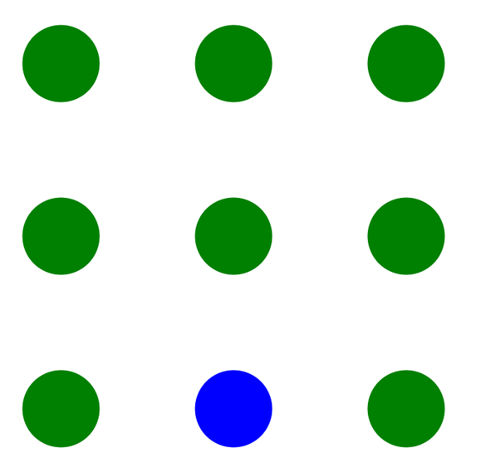
Rules of Engagement
Fixed Arena = 800 x 600 = 480,000
Hazard Radius – more susceptible
More infectious
3. Mingle Factor (”mF”) – role and
environment related
4. Population density

Slide 7
“Temporal dynamics in viral shedding and transmissibility of COVID-19”
Nature Medicine Aug 7 2020. Xi He, Eric HY Lau et al.
Susceptible
Incubating
Pre-symptomatic
Symptomatic
INERT
Infected
INFECTIOUS
onset
critical
Peak Viral Load
?? Approach
Use susc?
serious
3.0d
mild
T=0
2.2d
5.2d
21d
VIRAL LOAD AFFECTS SIZE → TRANSMITTABILITY

Slide 8
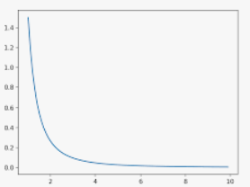
Move Generator
One move per cycle
n cycles per generation (1 gen = 1 hour)
Moves are minimum 0.5HzR
Propose-move algorithm stochastic selection from a Pareto-like distribution
Closer moves more likely than more distant ones – similar to negative binomial
mF then applied

Slide 9
Some Results
Fixed Universe – show SEIR dynamics
Multiverse and locality of transmissions
Multiverse and effects of vaccination
Studies of mF and HzR vs R0
Studies of transmission paths and trees
Studies of velocity of epidemic
Studies of territorial characteristics of paths

Slide 10

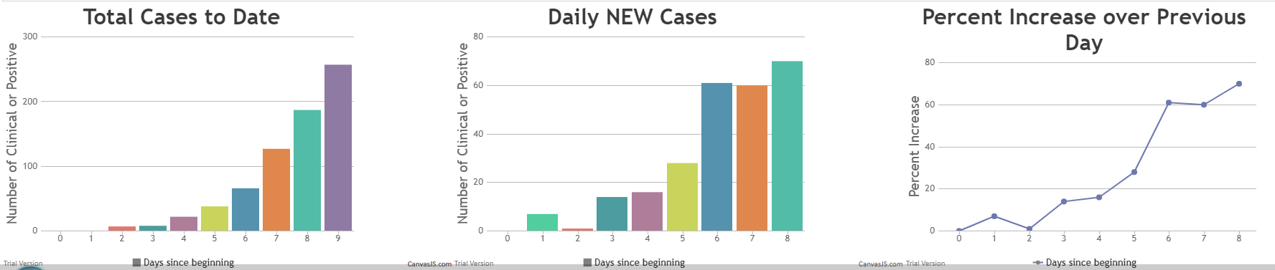
Visualize Data as Charts
AT ANY TIME, CLICK ON “SHOW CHARTS” AND SCROLL DOWN TO SEE
YOU CAN CHANGE THE PARAMETERS AT ANY STEP AND WATCH THE EPIDEMIC
SPEED UP OR SLOW DOWN

Slide 11
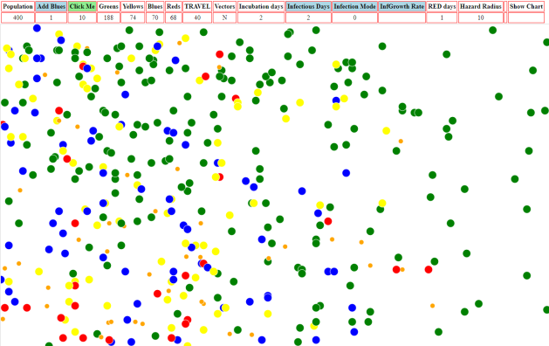
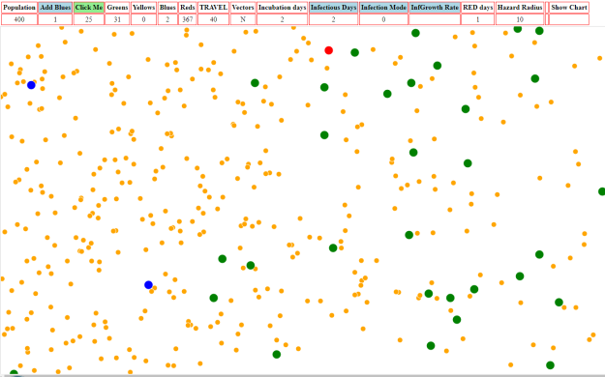
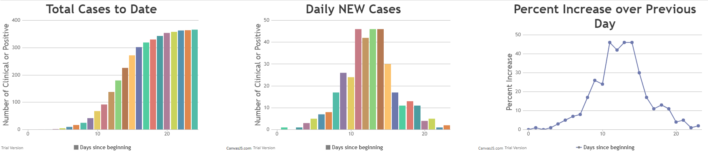
Trial 2 – Medium Hazard Radius High Travel
Population = 400 BLUES=1 TRAVEL=40 Incubation=2 Infectious=2 Hazard=10
10 days 25 days
widely dispersed few uninfected left (31)
The decrease in new rates is due to running out of susceptibles

Slide 12
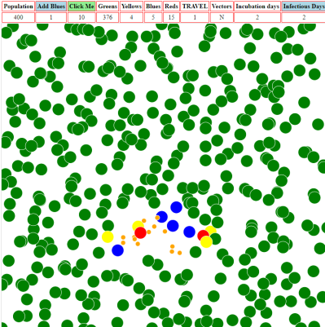
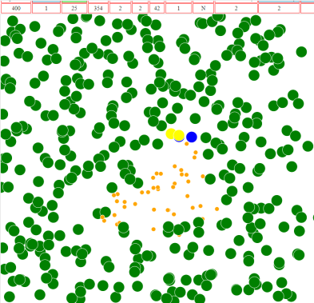
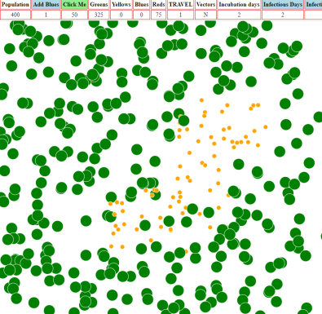
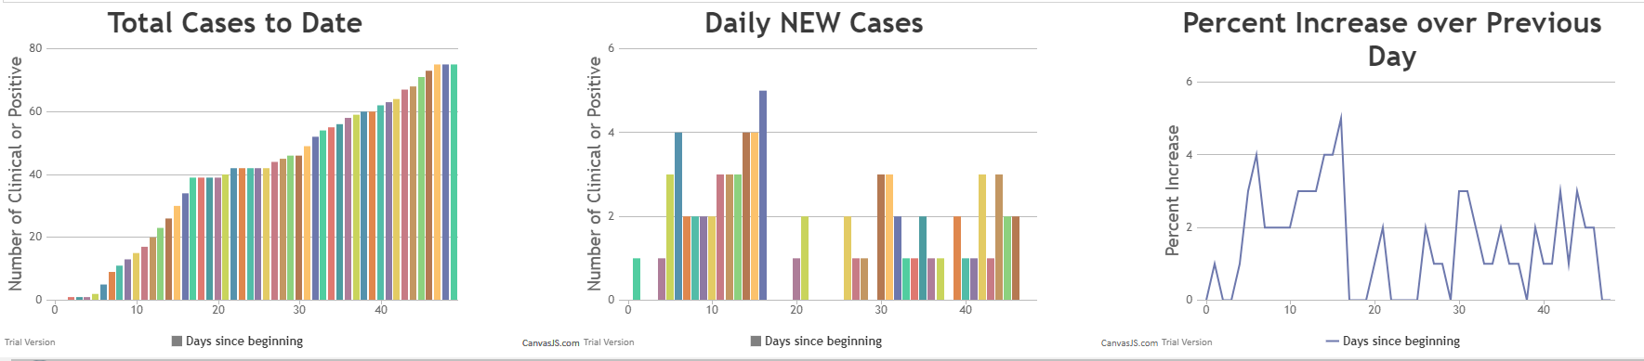
Trial 1 – High Hazard Radius Low Travel
Population = 400 BLUES=1 TRAVEL=1 Incubation=2 Infectious Days=2 Hazard=14
10 days 25 days 50 days
localized still localized self-limiting

Slide 13
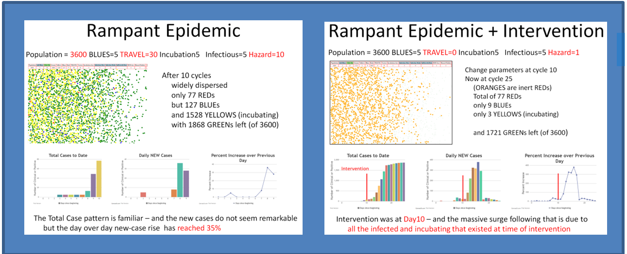
SEEING THEM SIDE BY SIDE
The April 7th version of CovidSim supports animation and simulation intervals

Slide 14
Some Results
Fixed Universe – show SEIR dynamics
Multiverse and locality of transmissions
Multiverse and effects of vaccination
Studies of mF and HzR vs R0
Studies of transmission paths and trees
Studies of velocity of epidemic
Studies of territorial characteristics of paths

Slide 15
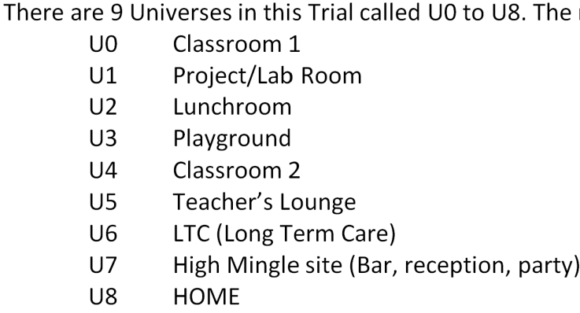
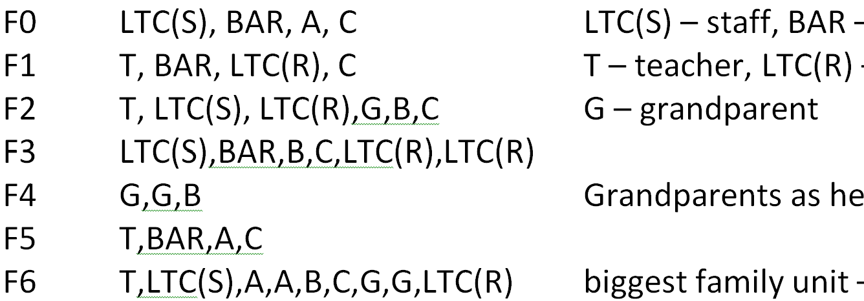
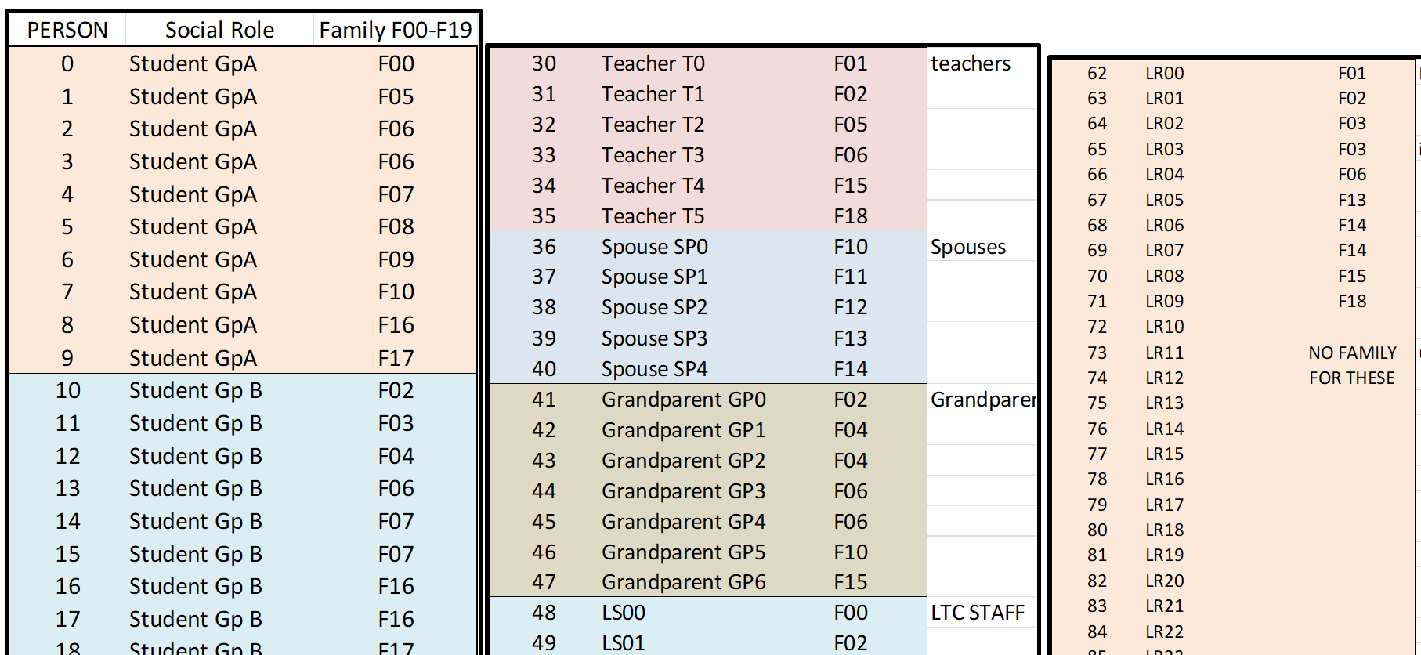
Multiverse
Family structure
Role assignment

Slide 16
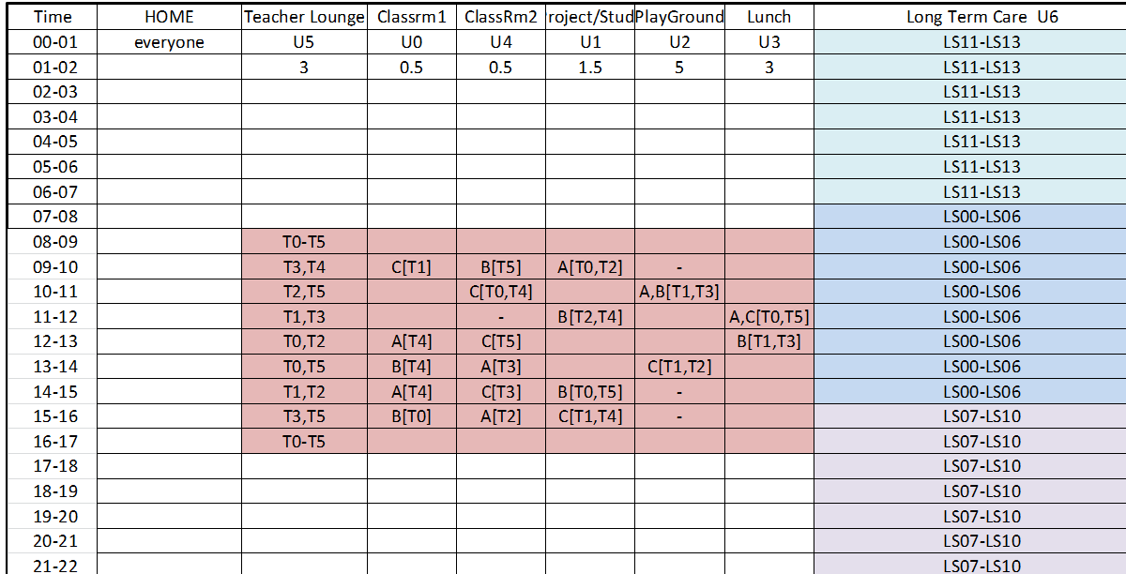
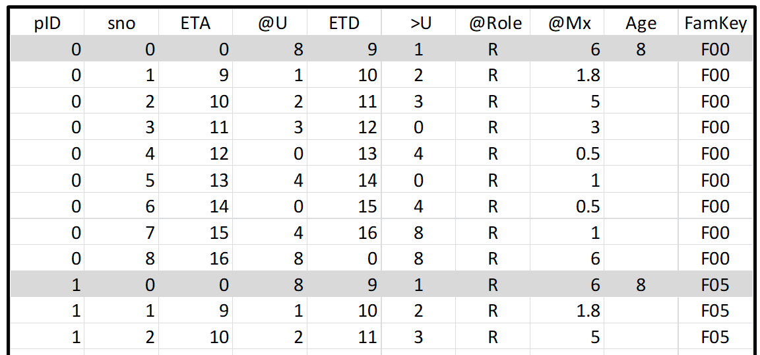
Part of schedule
Part of .csv file
Implementing
schedules

Slide 17
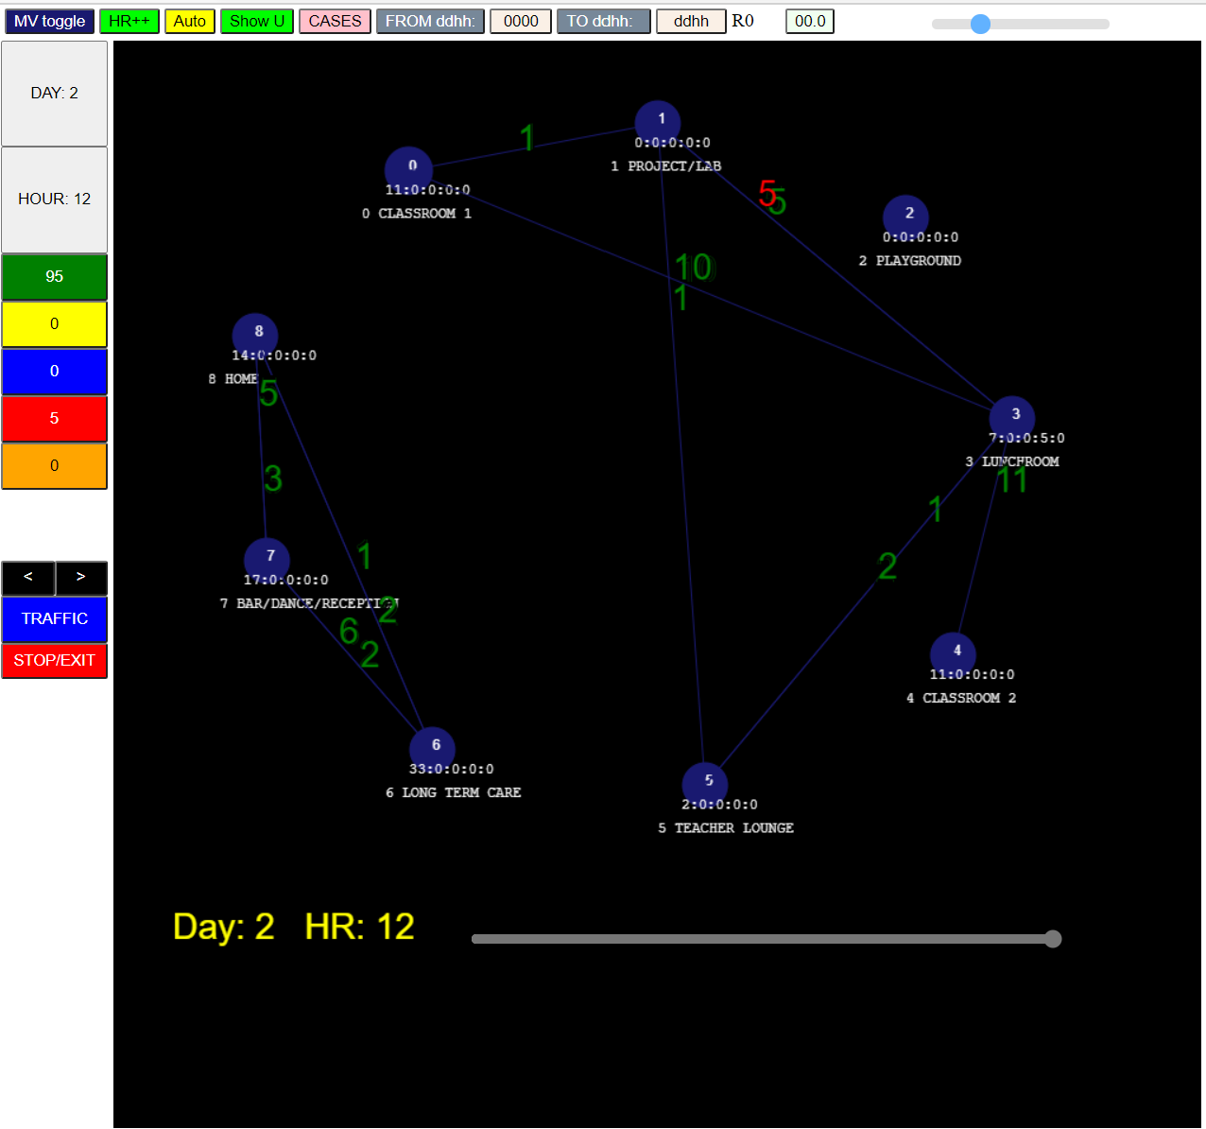

Slide 18
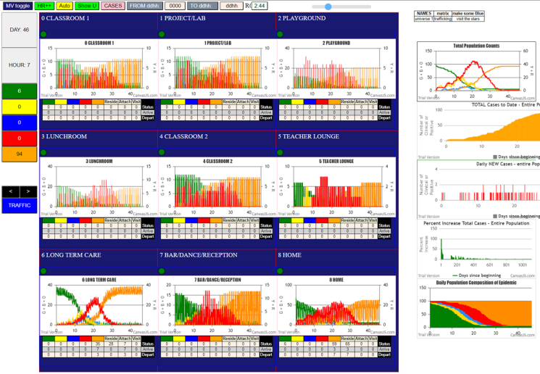
The Multiverse Model

Slide 19
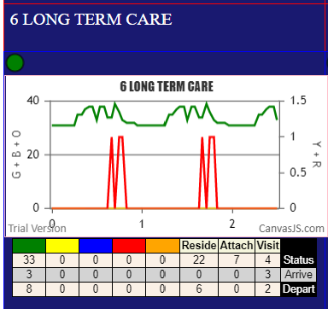
The green line are the
permanent Residents, plus
staff and visitors
The numbers fluctuate by
the hourly schedules
Shows 33 Greens (susceptibles) at time = right hand of X-axis
These are 22 Residents, 7 Attached (staff), 4 Visitors
In the past there were 1 Red, then another Red (symptomatic cases)

Slide 20
Some Results
Fixed Universe – show SEIR dynamics
Multiverse and locality of transmissions
Multiverse and effects of vaccination
Studies of mF and HzR vs R0
Studies of transmission paths and trees
Studies of velocity of epidemic
Studies of territorial characteristics of paths

Slide 21
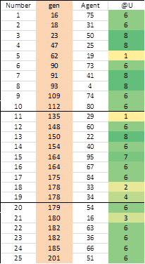
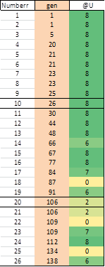
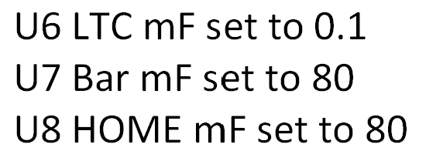
Locality of Transmission
LTC has 28 to 25 persons 24hs/day – density and duration high
Home infections within family only – mF set high
Throttle LTC
Accelerate Home
Result:
1st 10 –Home
1st 20 – H15, LTC2,….
1st 25 – H16, School 5,….
Out-of-Box
1st 10 – LTC 5, Home 4
1s 20 – LTC 10, H5, Sc 4
1st 25 – LTC 14, H 5, Sch6

Slide 22
Some Results
Fixed Universe – show SEIR dynamics
Multiverse and locality of transmissions
Multiverse and effects of vaccination
Studies of mF and HzR vs R0
Studies of transmission paths and trees
Studies of velocity of epidemic
Studies of territorial characteristics of paths

Slide 23
Vaccination Simulations
Assume Refuse Vaccination as 1/6 and efficacy as 95%
LTC
Home
Bar
School Playground
School Lunchroom
School Project/Lab
8
16
6
12
18
24
10
12
14
16
18
20
24
10
11
11
We assume that first dose has been given 23 days prior this this second dose
We select these separately to look at differences in population effects

Slide 24
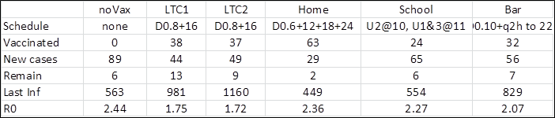
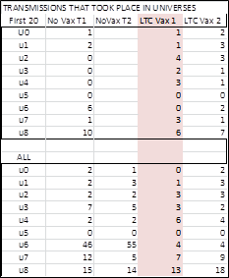
Vaccination Simulations
This shows that HOME reached 63 vaccinations, while LTC and Bar get 30s
Two trials of LTC at same parameters were run to test consistency
NoVax incurred 89 new transmissions, with school, bar, then LTC, home in order
Vaccinating in school alone conferred least protection
The second column on the left shows where infections occur
In the first 20 infections, and for all generations in the noVax case.
We see this is in U6(LTC) with 6 in first 20, and 46 in U6 for all.
When we vaccinate in LTC, the infections in 1st 20 are more mixed,
With U8 (home) at 6 and 7 larger than U2 (playground) at 4 and 3.
For all generations, U8 (home) dominates at 13 and 18, with the bar
next at 7 and 9 infections.
The distributed nature of HOME means general vax

Slide 25
Some Results
Fixed Universe – show SEIR dynamics
Multiverse and locality of transmissions
Multiverse and effects of vaccination
Studies of mF and HzR vs R0
Studies of transmission paths and trees
Studies of velocity of epidemic
Studies of territorial characteristics of paths

Slide 26
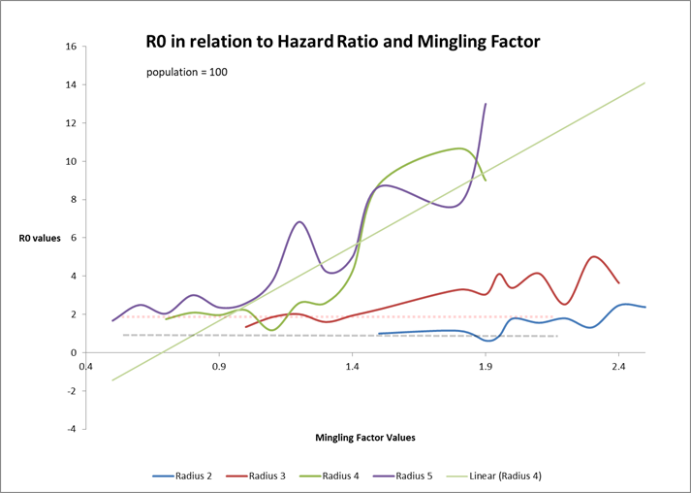

Slide 27
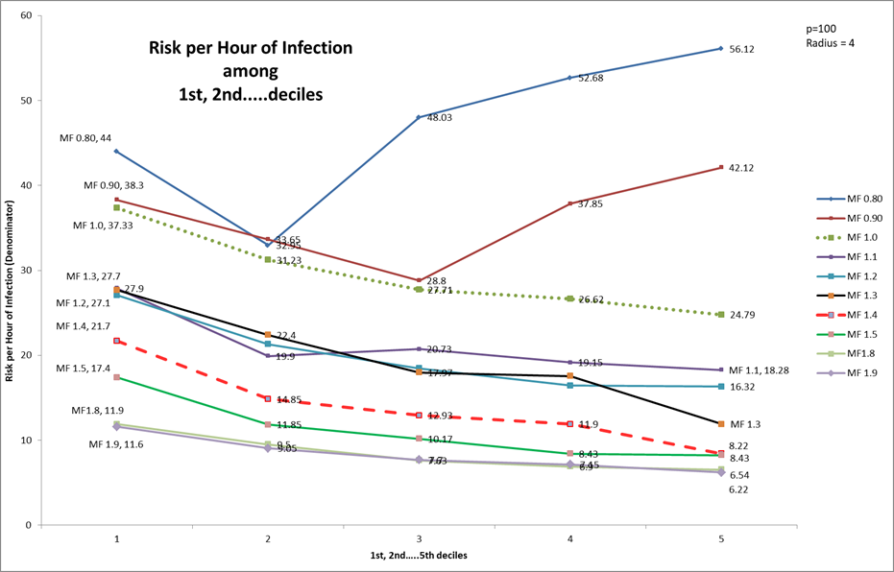
Que: How many generations to infect 10%, 20% etc of susceptibles?
Use a single universe to compute these metrics, where RPH has now
been replaced by “theta” but is just a fancy word meaning:
At time T=[gen], theta = gen/agents infected at T
where gen is the generation at which 10%, 20% are infected
Increasing values
mean slowing down
Decreasing slope
means acceleration

Slide 28
Some Results
Fixed Universe – show SEIR dynamics
Multiverse and locality of transmissions
Multiverse and effects of vaccination
Studies of mF and HzR vs R0
Studies of transmission paths and trees
Studies of velocity of epidemic
Studies of territorial characteristics of paths

Slide 29
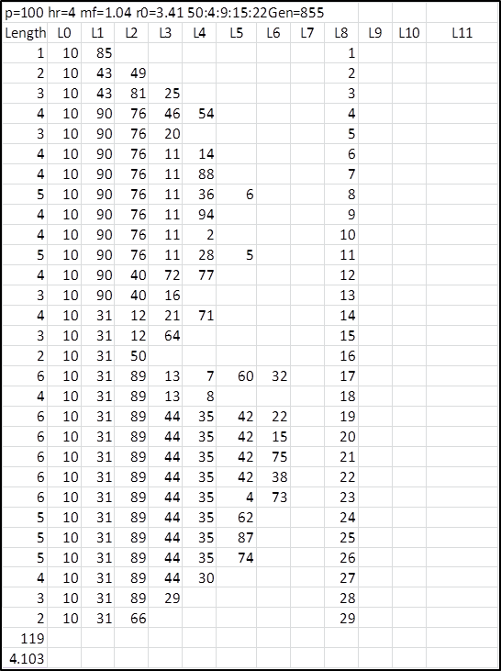
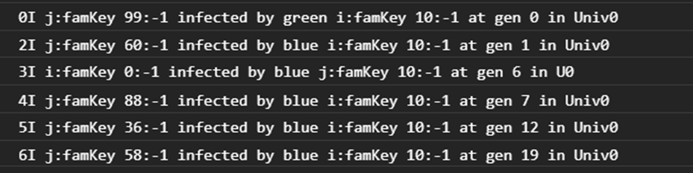
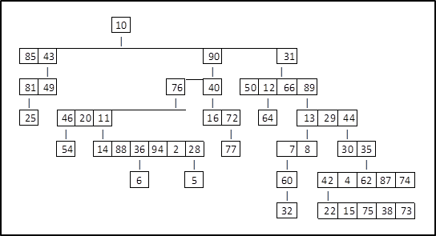
Transmission Paths and Trees
Console log
Who infects whom when
and where
Transmission paths
Transmission tree

Slide 30
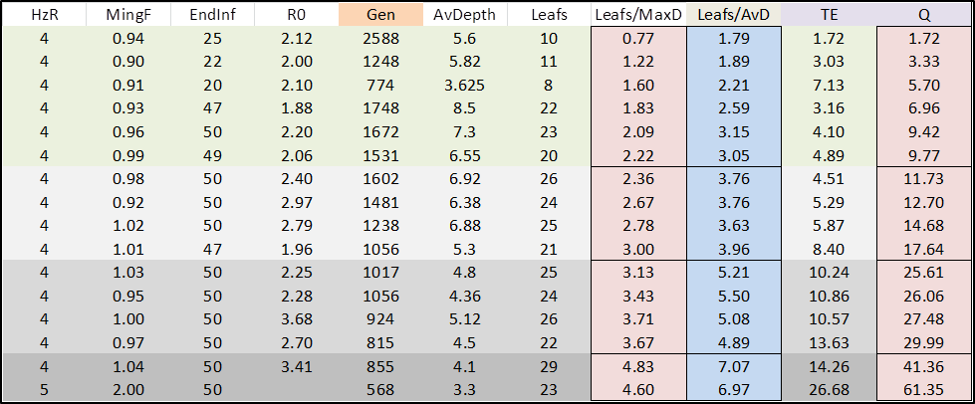
Transmission Paths and Trees
Observation: efficient epidemics have broad shallow trees which reflect
more simultaneous transmitters and more branching, with fewer
long sequences of single propagations by agents
Q = (Nodes/Av Depth) * (Leaves/Gen) * 100
The relationship between Q
and mF is clear

Slide 31
Some Results
Fixed Universe – show SEIR dynamics
Multiverse and locality of transmissions
Multiverse and effects of vaccination
Studies of mF and HzR vs R0
Studies of transmission paths and trees
Studies of velocity of epidemic
Studies of territorial characteristics of paths

Slide 32
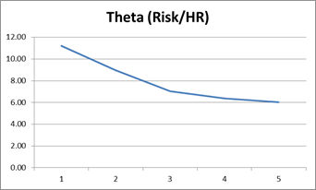

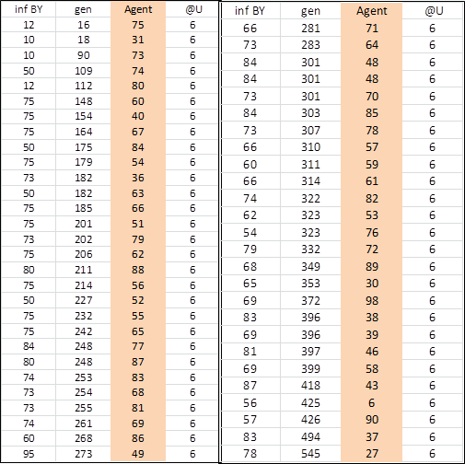
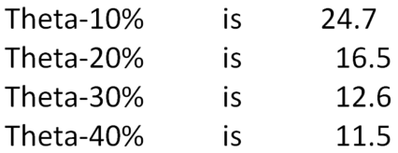
Multiverse Dynamics
Out-of-Box settings with five initial transmitters in LTC-school-bar multiverse
Que: how do the epidemics within each Universe contribute to overall effects
Console log tells us at each transmission: generation, who infects whom where
For the entire population
Recall theta is the time between
transmissions in a time-frame
The downslope tells us
the epidemic is accelerating
There are 55 transmissions within LTC, going
from gen 16 to gen 545…
These values are
higher than for the
population as a whole, so
progression is slower

Slide 33
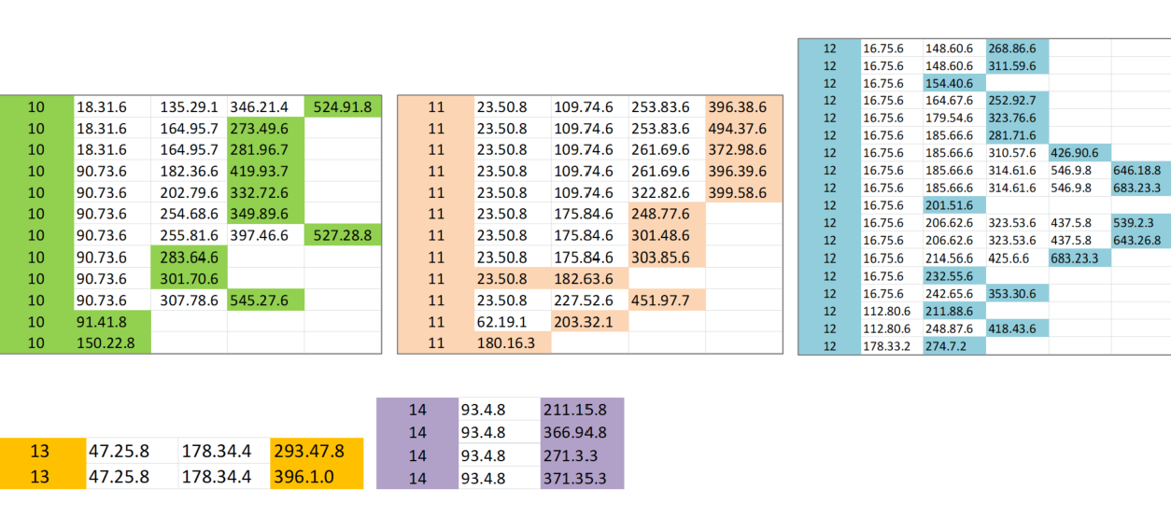
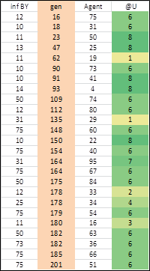
Transmission Trees for 5 initial transmitters
Root 10 Q 18.96
Root 11 Q 16.64
Root 12 Q 28.12
Root 13 Q 0.67
Root 14 Q 2.69
What we don’t know
from this is where and
when these infections
took place
Of the first 25 transmissions,
14 were in U6 (LTC)
5 were in U8 (Home)
5 were in School U’s
1 was in U7 (bar)

Slide 34
Some Results
Fixed Universe – show SEIR dynamics
Multiverse and locality of transmissions
Multiverse and effects of vaccination
Studies of mF and HzR vs R0
Studies of transmission paths and trees
Studies of velocity of epidemic
Studies of territorial characteristics of paths

Slide 35
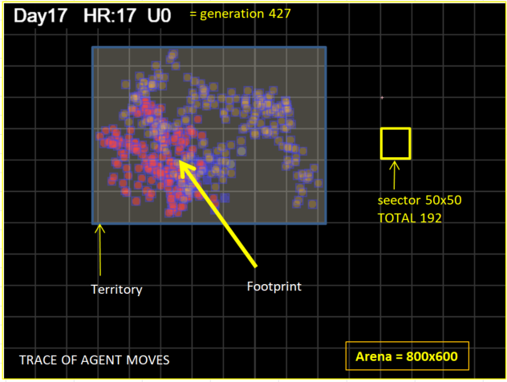
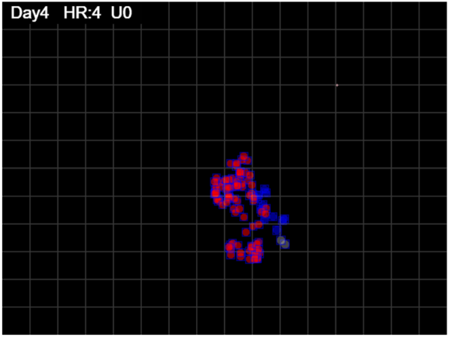
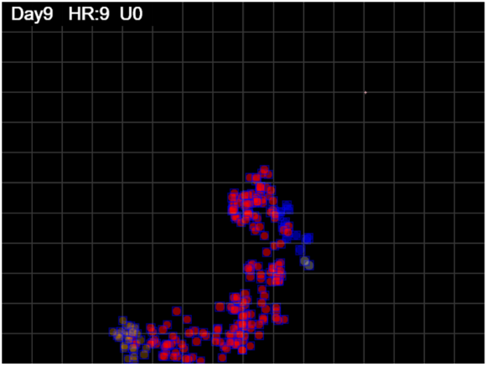
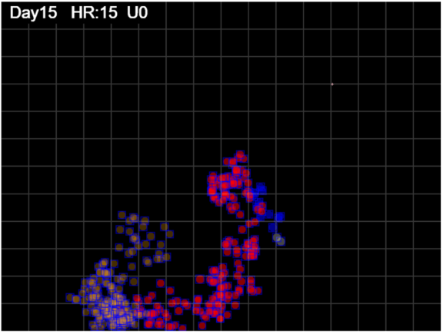
Spacing = Territory/footprint
how sparse the territory is
Coverage = Territory/Arena
proportion of arena
mF affects growth of territory which
reflected in changes in spacing
Increase in territory
Increase Spacing
Same Territory
Decrease spacing
(movement within)

Slide 36
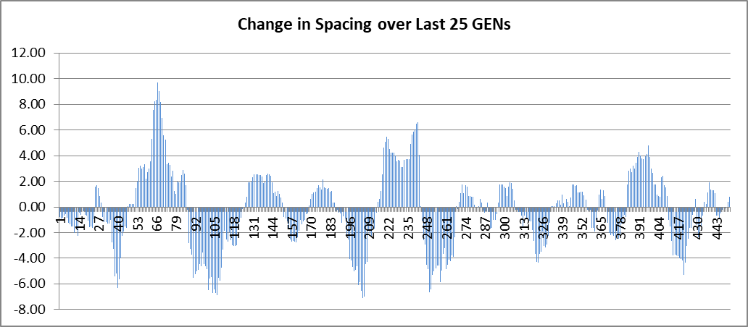
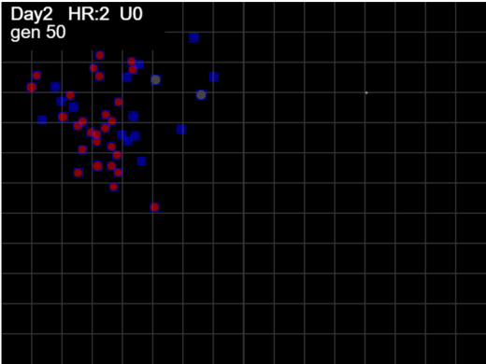
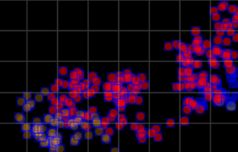
How much territory in last 25 moves compared to the similar territory 25 generations ago?
A rise means that
the 25-generation frame
has increased from before,
so motion is expansionist
Decrease means tighter
clustered moves compare to before
HOW DOES THIS MATTER?
If the territory does not overlap with that of another agent, they will never
meet and therefore no transmission can occur
This illustrates the opportunity for contagion
for the two agents who have created these
two territories
mF 3.2 large territory

Slide 37
Discussion
CovidSIMVL is a generator of cases, transmission paths and transmission trees in heterogenous environments for variations in population density, mobility and risk.
It can be used to study in detail the dynamics of epidemics not available in accidental worlds
The equivalences may be created by fitting data from CovidSIMVL using equation-based approaches to find correlation tables, from which reverse optimization can generate the CovidSIMVL parameter matching an accidental epidemic
Synthetic
Epidemidic
data
EQ-based model
Matching
parameters
CovidSIMVL
Matching
parameters

